Slide 1



Synthetic File System

Slide 2
GOAL
01
02
03
To be continued by GRAU Data...
Develop a virtual file system that provides a unified view on a pre-configured set of existing data sources
Filter the sources for data, given some requirements using their Metadata
Use the filtered datasets for multiple use cases, like medical image processing or natural language processing

Slide 3
Why would we want to unify the data in a filesystem?
We have different sources, like databases, remote folders, or even OEM applications like the MDH
All of them have different ways to access them
Well, that's annoying :(
So why not just have one view on all of them, abstracting all that nonsense away?
But on what underlying structure do we build this view?
Everyone is used to working with a regular filesystem, so let's just use that!

Slide 4
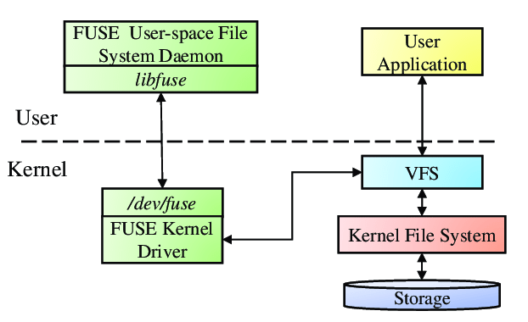
What exactly is a virtual File System?
For a real File system to implement you would have to write a proper kernel module, etc...
With a File System in User Space (FUSE) you can create your own "Filesystem", by just overwriting the Linux filesystem calls
Sounds a lot easier, let's use this!

Slide 5
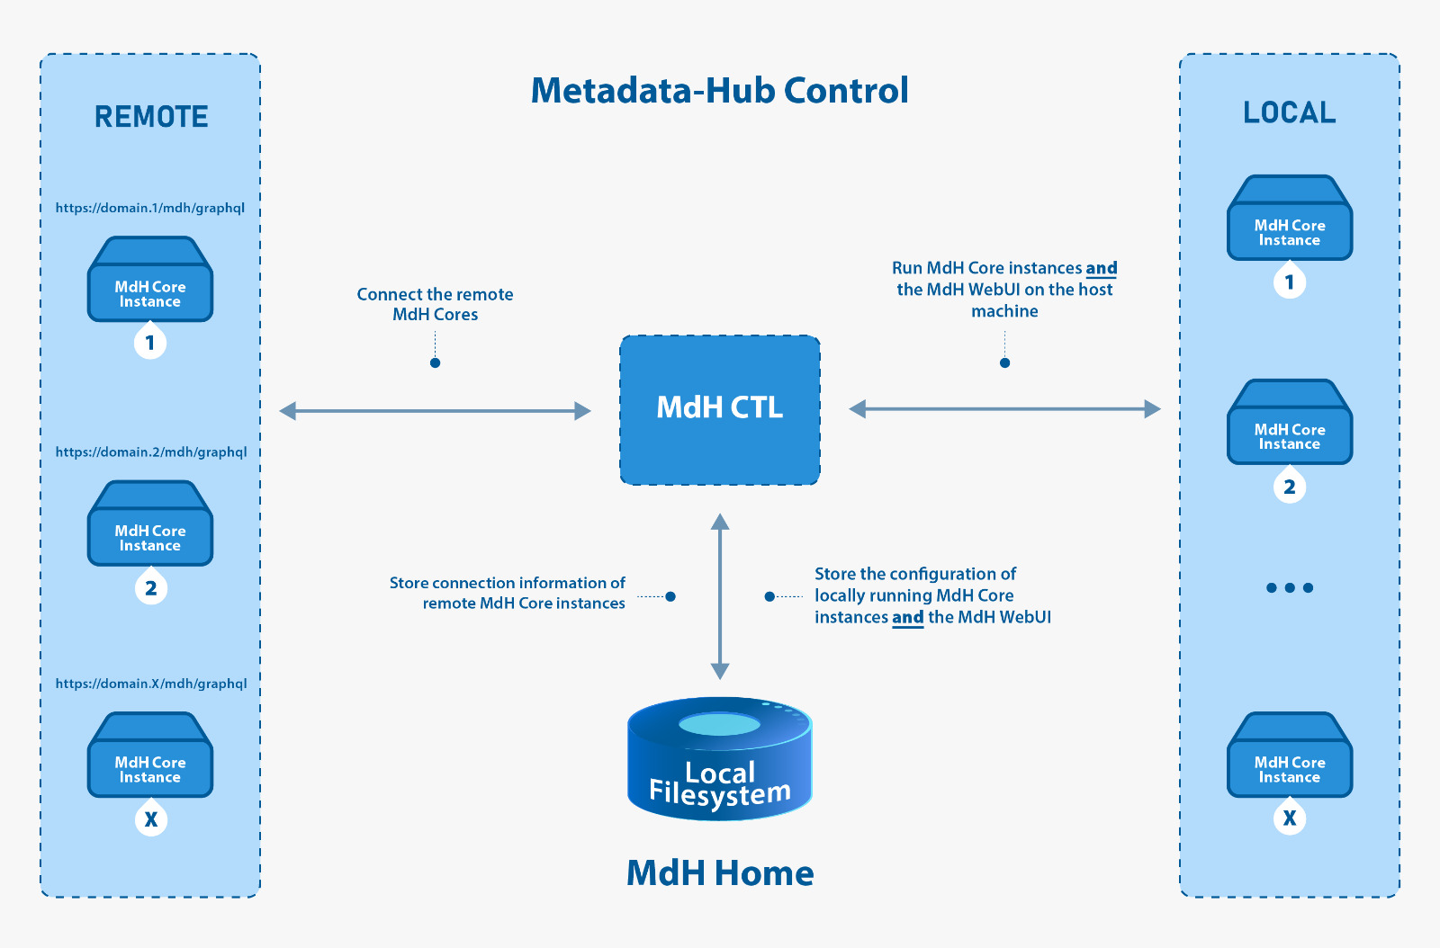
The Metadata Hub (MDH)
The main data source that was implemented for the project
Allows to harvest files and categorizes them by their metadata
Query files regarding their metadata

Slide 6
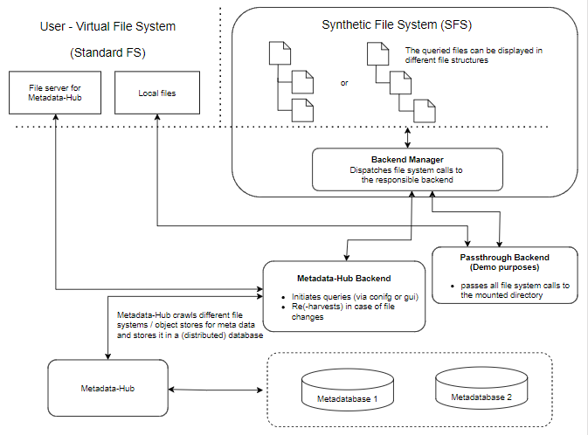
The SFS Architecture

Slide 7
DEMO

Slide 8


Slide 9


THANK YOU!

